Slide 1



Noida Institute of Engineering and Technology, Greater Noida
Data Handling
Unit: 2
Data Analytics ACSAI0512
Dr. Kumod Kumar Gupta
Assistant Professor
CSE-AI
B.Tech 5th Semester

Slide 2
Faculty Introduction
Name | Dr. Kumod Kumar Gupta
Qualification | PhD (Artificial Intelligence)
Designation | Assistant Professor
Department | AI
NIET Experience | 2 Years
Subject Taught | Data Analytics, Introduction to Artificial Intelligence, Machine Learning, and Deep Learning

Slide 3
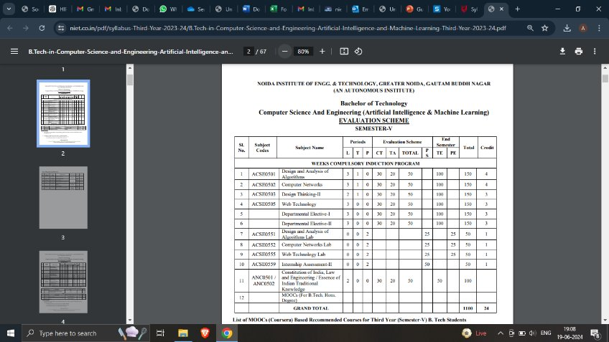
Evaluation Scheme

Slide 4
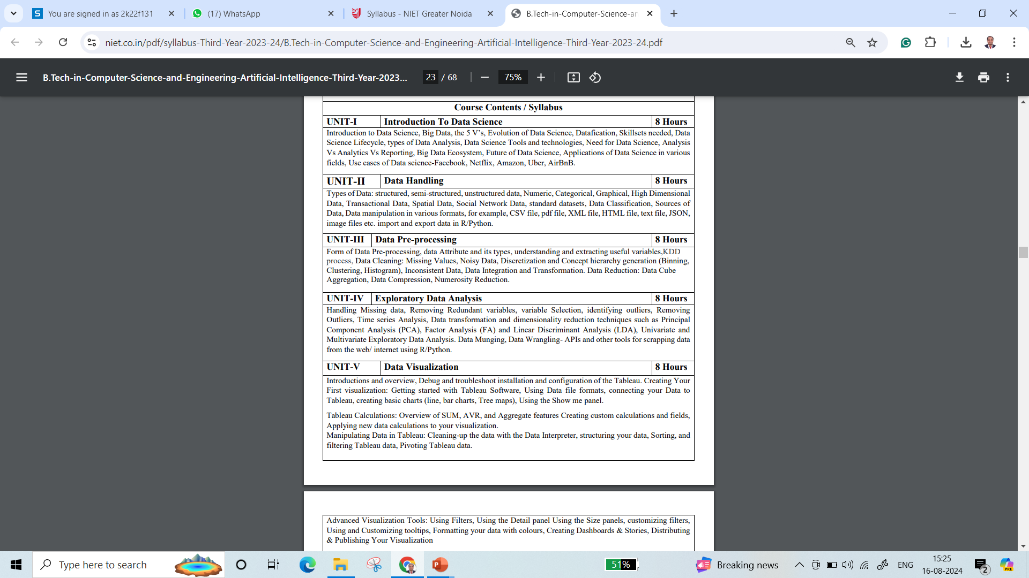
Syllabus

Slide 5
Syllabus
UNIT-I: Introduction to Data Science
Introduction to Data Science, Big Data, the 5 V’s, Evolution of Data Science, Datafication, Skillsets needed, Data Science Lifecycle, types of Data Analysis, Data Science Tools and technologies, Need for Data Science, Analysis Vs Analytics Vs Reporting, Big Data Ecosystem, Future of Data Science, Applications of Data Science in various fields, Use cases of Data science-Facebook, Netflix, Amazon, Uber, AirBnB.

Slide 6
Syllabus
UNIT-II: Data Handling
Type of Data: structured, semi-structured, unstructured data, Numeric, Categorical, Graphical, High Dimensional Data, Transactional Data, Spatial Data, Social Network Data, standard datasets, Data Classification, Sources of Data, Data manipulation in various formats, for example, CSV file, pdf file, XML file, HTML file, text file, JSON, image files etc. import and export data in R/Python.

Slide 7
Syllabus
UNIT-III: Data Preprocessing
Form of Data Pre-processing, data Attribute and its types, understanding and extracting useful variables,KDD process, Data Cleaning: Missing Values, Noisy Data, Discretization and Concept hierarchy generation (Binning, Clustering, Histogram), Inconsistent Data, Data Integration and Transformation. Data Reduction: Data Cube Aggregation, Data Compression, Numerosity Reduction

Slide 8
Syllabus
UNIT-IV: Exploratory Data Analysis
Handling Missing data, Removing Redundant variables, variable Selection, identifying outliers, Removing Outliers, Time series Analysis, Data transformation and dimensionality reduction techniques such as Principal Component Analysis (PCA), Factor Analysis (FA) and Linear Discriminant Analysis (LDA), Univariate and Multivariate Exploratory Data Analysis. Data Munging, Data Wrangling- APIs and other tools for scrapping data from the web/ internet using R/Python.

Slide 9
Syllabus
UNIT-V: Data Visualization
Introductions and overview, Debug and troubleshoot installation and configuration of the Tableau. Creating Your First visualization: Getting started with Tableau Software, Using Data file formats, connecting your Data to Tableau, creating basic charts (line, bar charts, Tree maps), Using the Show me panel. Tableau Calculations: Overview of SUM, AVR, and Aggregate Features Creating custom calculations and fields, Applying new data calculations to your visualization. Manipulating Data in Tableau: Cleaning-up the data with the Data Interpreter, structuring your data, Sorting, and filtering Tableau data, Pivoting Tableau data. Advanced Visualization Tools: Using Filters, Using the Detail panel Using the Size panels, customizing filters, Using and Customizing tooltips, Formatting your data with colours, Creating Dashboards & Stories, Distributing & Publishing Your Visualization

Slide 10
Branch Wise Applications
1.Security
2. Digital Advertising
3. E-Commerce
4. Publishing
5. Massively Multiplayer Online Games
6. Backend Services and Messaging
7. Project Management & Collaboration
8. Real time Monitoring Services
9.Live Charting and Graphing
10. Group and Private Chat

Slide 11
Course Objective
The objective of this course is to understand the fundamental concepts of Data analytics and learn about various types of data formats and their manipulations. It helps students to learn exploratory data analysis and visualization techniques in addition to R/Python/Tableau programming language.

Slide 12
Course Outcomes
At the end of course, the student will be able to:
Understand the fundamental concepts of data analytics in the areas that plays major role within the realm of data science.
Explain and exemplify the most common forms of data and its representations.
Understand and apply data pre-processing techniques.
Analyse data using exploratory data analysis.
Illustrate various visualization methods for different types of data sets and application scenarios.

Slide 13
Program Outcomes
Engineering Graduates will be able to:
PO1 : Engineering Knowledge
PO2 : Problem Analysis
PO3 : Design/Development of solutions
PO4 : Conduct Investigations of complex problems
PO5 : Modern tool usage
PO6 : The engineer and society

Slide 14
Program Outcomes
Engineering Graduates will be able to:
PO7 : Environment and sustainability
PO8 : Ethics
PO9 : Individual and teamwork
PO10 : Communication
PO11 : Project management and finance
PO12 : Life-long learning

Slide 15

CO-POs Mapping
CO.K | PO1 | PO2 | PO3 | PO4 | PO5 | PO6 | PO7 | PO8 | PO9 | PO10 | PO11 | PO12
CO1 | 2 | 2 | 2 | 3 | 3 | - | - | - | - | - | - | -
CO2 | 3 | 2 | 3 | 2 | 3 | - | - | - | - | - | - | -
CO3 | 3 | 2 | 3 | 2 | 3 | - | - | - | - | - | - | -
CO4 | 3 | 2 | 3 | 2 | 3 | - | - | - | - | - | - | -
CO5 | 3 | 2 | 3 | 3 | 3 | - | - | - | - | - | - | -
AVG | 2.8 | 2.0 | 2.8 | 2.4 | 3.0 | - | - | - | - | - | - | -

Slide 16

Program Specific Outcomes
S. No. | Program Specific Outcomes (PSO) | PSO Description
1 | PSO1 | Design innovative intelligent systems for the welfare of the people using machine learning and its applications.
2 | PSO2 | Demonstrate ethical, professional and team - oriented skills while providing innovative solutions in Artificial Intelligence and Machine Learning for life-long learning.

Slide 17
CO-PSOs Mapping
CO.K | PSO1 | PSO2 | PSO3 | PSO4
CO1 | 3 | - | - | -
CO2 | 3 | 2 | - | -
CO3 | 3 | 3 | - | -
CO4 | 3 | 3 | - | -
CO5 | 3 | 3 | - | -

Slide 18
Program Educational Objectives
Program Educational Objectives (PEOs) | PEOs Description
PEOs | Pursue higher education and professional career to excel in the field of Artificial Intelligence and Machine Learning.
PEOs | Lead by example in innovative research and entrepreneurial zeal for 21st century skills.
PEOs | Proactively provide innovations solutions for societal problems to promote life-long learning.
Aarushi Thusu ACSAI0622 Social Media Analytics Unit 5

Slide 19
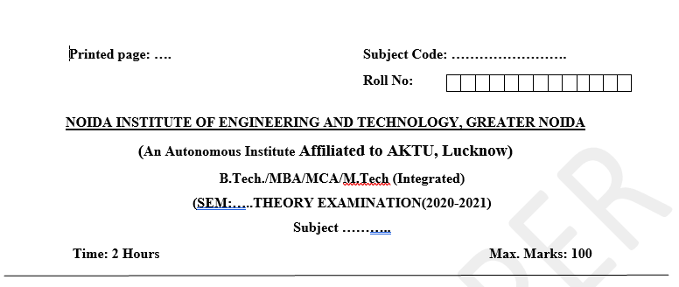
Pattern of External Exam Question Paper

Slide 20
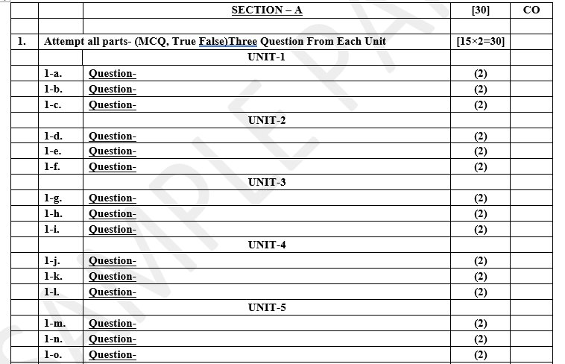
Pattern of External Exam Question Paper

Slide 21
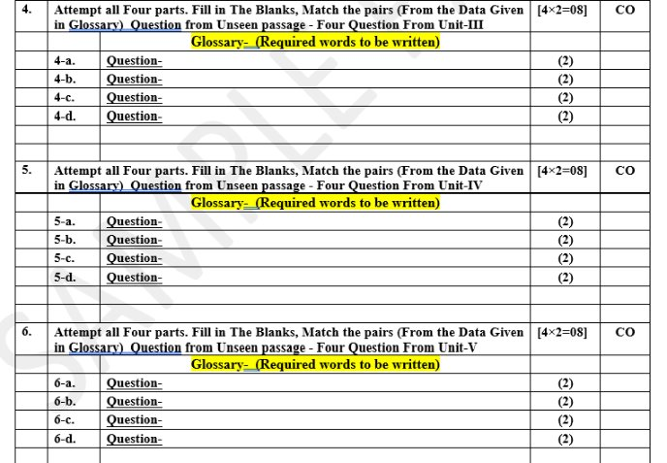
Pattern of External Exam Question Paper

Slide 22
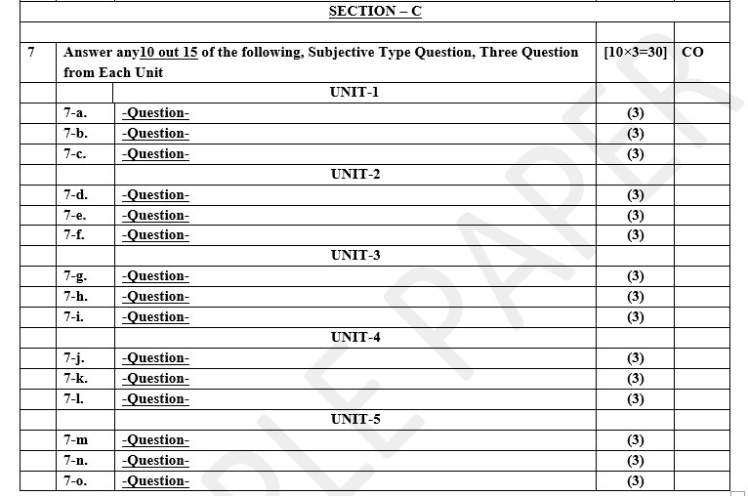
Pattern of External Exam Question Paper

Slide 23
Brief Introduction about the Subject and Videos
Data analytics (DA) is the area of examining data sets in order to find trends and draw conclusions about the information they contain. Increasingly, data analytics is done with the aid of specialized systems and software.
YouTube/other Video Links
https://www.youtube.com/watch?v=KxryzSO1Fjs

Slide 24
Unit Content
Types of Data: structured, semi-structured, unstructured data,
Numeric, Categorical, Graphical, High Dimensional Data,
Transactional Data, Spatial Data,
Social Network Data,
standard datasets,
Data Classification,
Sources of Data, Data manipulation in various formats,
for example, CSV file, pdf file, XML file, HTML file, text file, JSON, image files etc. import and export data in R/Python.

Slide 25
Unit Objectives
To provide an overview of an exciting growing field of data science.
To inculcate the preliminary knowledge of handling data , discuss various types of data.
Types if file system used while handling data.
Data Wrangling and Messy data preprocessing.

Slide 26
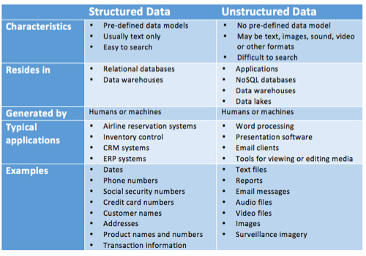
Types of Data: Structured, Unstructured and Semi Structured

Slide 27
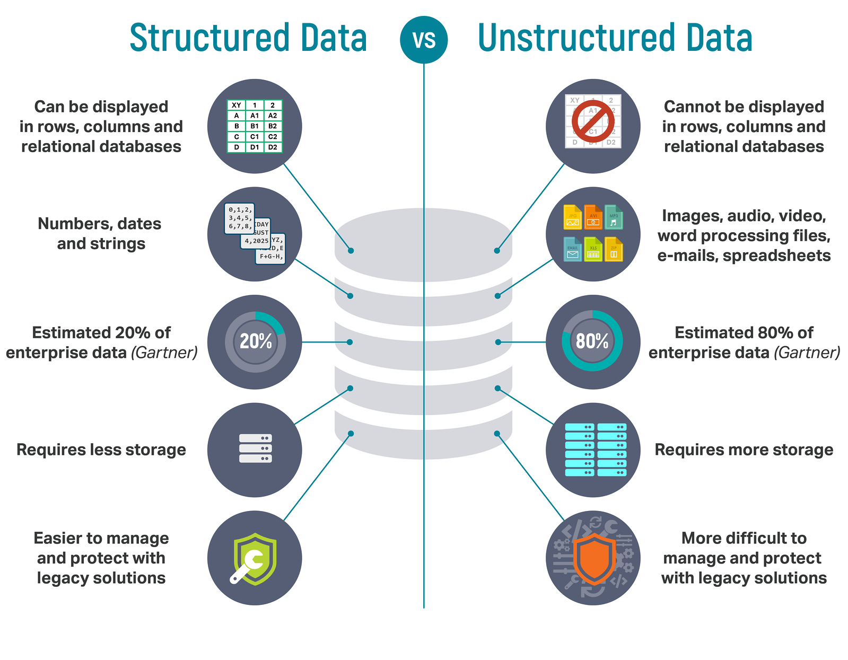
Types of Data: Structured, Unstructured and Semi Structured

Slide 28
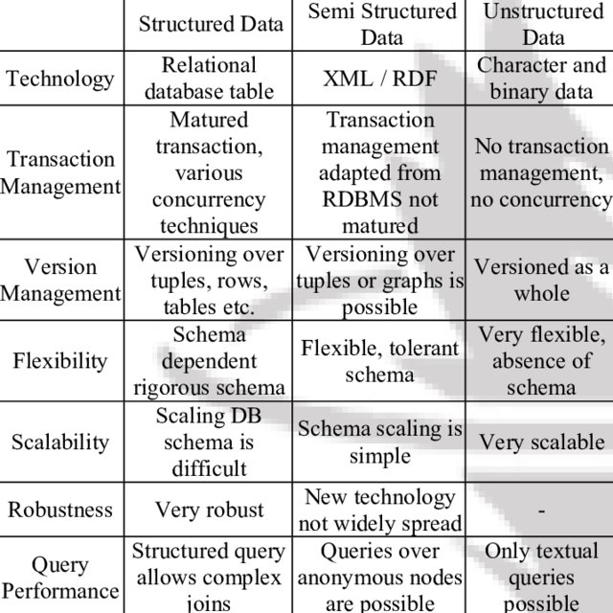
Types of Data: Structured, Unstructured and Semi Structured

Slide 29
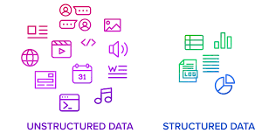
Types of Data: Structured, Unstructured and Semi Structured
Structured data refers to data that is organized and formatted in a specific way to make it easily readable and understandable by both humans and machines.
This is typically achieved using a well-defined schema or data model, which provides a structure for the data.
Structured data is typically found in databases and spreadsheets and is characterized by its organized nature. Each data element is typically assigned a specific field or column in the schema, and each record or row represents a specific instance of that data.
For example, in a customer database, each record might contain fields for the customer’s name, address, phone number, and email address.

Slide 30
Types of Data (Contd….)
Characteristics of Structured Data:
Data conforms to a data model and has easily identifiable structure.
Data is stored in the form of rows and columns Example : Database
Data is well organized so, Definition, Format and Meaning of data is explicitly known.
Data resides in fixed fields within a record or file.
Similar entities are grouped together to form relations or classes.
Entities in the same group have same attributes.
Easy to access and query, So data can be easily used by other programs.
Data elements are addressable, so efficient to analyse and process.

Slide 31
Types of Data (Contd….)
Sources of Structured Data:
SQL Databases
Spreadsheets such as Excel
OLTP Systems
Online forms
Sensors such as GPS or RFID tags
Network and Web server logs
Medical devices
Advantages of Structured Data:
Structured data have a well-defined structure that helps in easy storage and access of data.
Data can be indexed based on text string as well as attributes. This makes search operation hassle-free.
Data mining is easy i.e. knowledge can be easily extracted from data.

Slide 32
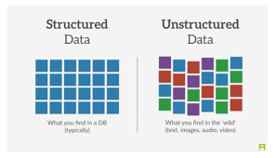
Types of Data
Unstructured Data:
Unstructured data is the data which does not conforms to a data model and has no easily identifiable structure such that it cannot be used by a computer program easily.
Unstructured data is not organized in a pre-defined manner or does not have a pre-defined data model; thus, it is not a good fit for a mainstream relational database.

Slide 33
Types of Data (Contd….)
Characteristics of Unstructured Data:
Data neither conforms to a data model nor has any structure.
Data cannot be stored in the form of rows and columns as in Databases
Data does not follow any semantic or rules
Data lacks any format or sequence
Data has no easily identifiable structure
Due to lack of identifiable structure, it cannot used by computer programs easily
Sources of Unstructured Data:
Web pages
Images (JPEG, GIF, PNG, etc.)
Videos
Reports
Word documents and PowerPoint presentations
Surveys

Slide 34
Types of Data (Contd…..)
Advantages of Unstructured Data:
It supports the data which lacks a proper format or sequence
The data is not constrained by a fixed schema
Very Flexible due to absence of schema.
Data is portable
It is very scalable
It can deal easily with the heterogeneity of sources.
These type of data have a variety of business intelligence and analytics applications.

Slide 35
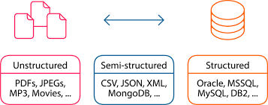
Types of Data
Semi structured Data:
Semi-structured data is a type of data that is not purely structured, but also not completely unstructured.
It contains some level of organization or structure but does not conform to a rigid schema or data model and may contain elements that are not easily categorized or classified.
Semi-structured data is becoming increasingly common as organizations collect and process more data from a variety of sources, including social media, IoT devices, and other unstructured sources.
While semi-structured data can be more challenging to work with than strictly structured data, it offers greater flexibility and adaptability, making it a valuable tool for data analysis and management.

Slide 36
Types of Data
Sources of Semi structured Data:
E-mails
XML and other markup languages(Extensible Markup Language. It is a markup language used for storing and transporting data in a structured format that is both human-readable and machine-readable)
Binary executables
TCP/IP packets
Zipped files
Integration of data from different sources
Web pages
Characteristics of Semi structured Data:
Data does not conform to a data model but has some structure.
Data cannot be stored in the form of rows and columns as in Databases.
Semi-structured data contains tags and elements (Metadata) which is used to group data and describe how the data is stored.
Similar entities are grouped together and organized in a hierarchy.

Slide 37
Types of Data (Contd….)
Advantages of Semi structured Data:
The data is not constrained by a fixed schema.
Flexible i.e Schema can be easily changed.
Data is portable.
It is possible to view structured data as semi-structured data.
Its supports users who cannot express their need in SQL(Structured Query Language. It is a standard language used to manage and manipulate relational databases by querying, updating, and managing the data stored within them).
It can deal easily with the heterogeneity of sources.

Slide 38
Types of Data
Characteristic | Structured | Unstructured | Semi structured
Mapping | Data is mapped by Relational Database | Data is mapped on the basis of binary and simple character | Data is mapped with XML/RDF
Scalability | Data is schema dependent, which makes it less flexible and scalable | Due to no dependency, unstructured data is flexible and scalable as well | Semi structure data is more scalable and flexible than flexible structures data, but less flexible when
Performance | Guarantees highest performance with structure query | Only Textual query is executable | Only allows anonymous queries
Organized | Highly Organized Data | Unorganized data | Partially organized Data
RDF stands for Resource Description Framework. It is a standard model used for representing information about resources on the web, typically in the form of subject-predicate-object expressions, often called triples. RDF is commonly used in semantic web technologies to structure and link data across different systems.

Slide 39
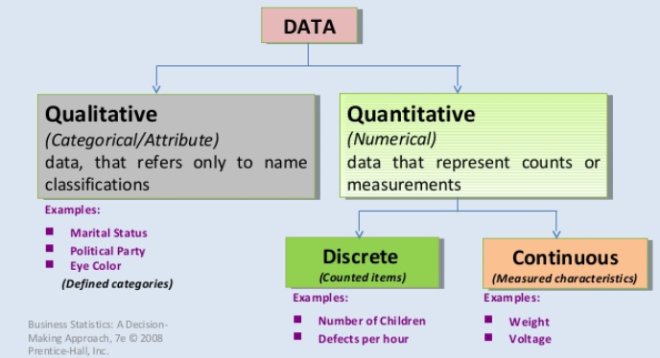
Types of Data: Numeric, Categorical, Graphical, High Dimensional

Slide 40
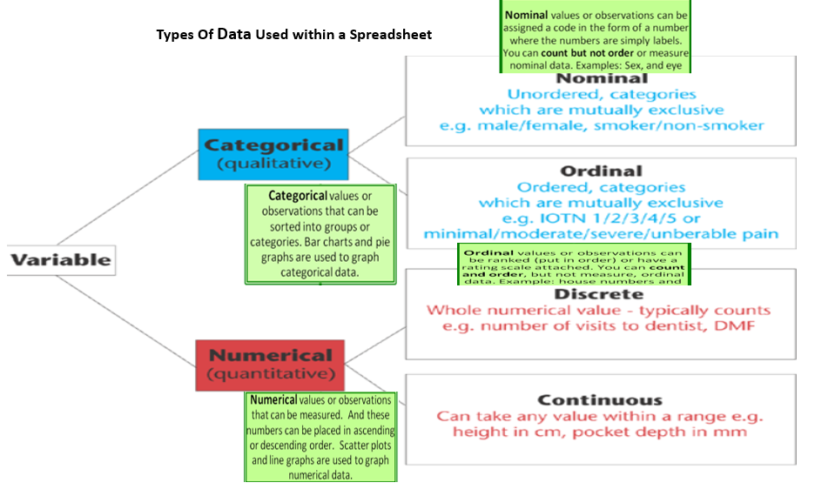
Types of Data: Numeric, Categorical, Graphical, High Dimensional

Slide 41
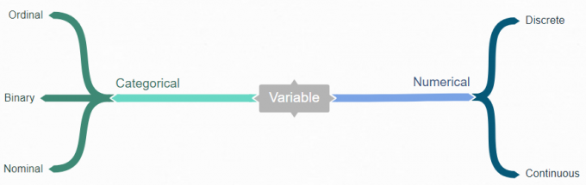
Types of Data: Numeric, Categorical, Graphical, High Dimensional
There are two types of variables you’ll find in your data – numerical and categorical. Numerical data can be divided into continuous or discrete values. And categorical data can be broken down into nominal and ordinal values.
Nominal Values: These are categories or labels without any particular order. For example, "red", "blue", and "green" are nominal values for colors. You can't say one is "greater" or "less" than the other.
Ordinal Values: These categories have a specific order or ranking. For example, "small", "medium", and "large" have an inherent order, where "large" is greater than "medium", and "medium" is greater than "small".

Slide 42

Types of Data: Numeric, Categorical, Graphical, High Dimensional
Numerical Data: Numerical data can further be classified into two categories:
A) Discrete Data: Discrete data contains the data which have discrete numerical values for example Number of Children, Defects per Hour etc.
B) Continuous Data: Continuous data contains the data which have continuous numerical values for example Weight, Voltage etc.

Slide 43
Types of Data: Numeric, Categorical, Graphical, High Dimensional
Types of categorical data
Categorical data often includes values and observations that can be categorized or grouped. Bar graphs and pie charts are the best ways to show this data. More specifically, there are two kinds of categorical data:
Nominal Data
Ordinal Data
Nominal Data
Nominal data is a type of data that consists of categories that can’t be ordered or ranked. It is also called a nominal scale. . Nominal data can’t be ranked or measured in any way. Still, nominal data can be both qualitative and quantitative at times.
Some examples of nominal data are symbols, words, letters, and the gender of a person.
Ordinal Data
Ordinal data is a category of data that has a natural order. It is often used in surveys, questionnaires, and the fields of finance and economics. Ordinal data stands out since it is impossible to differentiate between data values.
Clothing sizes are one example of this type of data (small, medium, and large are not measurable differences, but they are clearly ordered to show size comparisons).

Slide 44
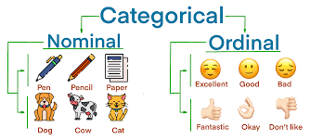
Types of Data: Numeric, Categorical, Graphical, High Dimensional

Slide 45
Types of Data: Numeric, Categorical, Graphical, High Dimensional
Graphical Data:
Graphical Representation of Data,” where numbers and facts become lively pictures and colorful diagrams. Instead of staring at boring lists of numbers, we use fun charts, cool graphs, and interesting visuals to understand information better.
In this exciting concept of data visualization, we’ll learn about different kinds of graphs, charts, and pictures that help us see patterns and stories hidden in data.
Graphics Representation is a way of representing any data in picturized form. It helps a reader to understand the large set of data very easily as it gives us various data patterns in visualized form.
There are two ways of representing data,
Tables
Pictorial Representation through graphs.

Slide 46
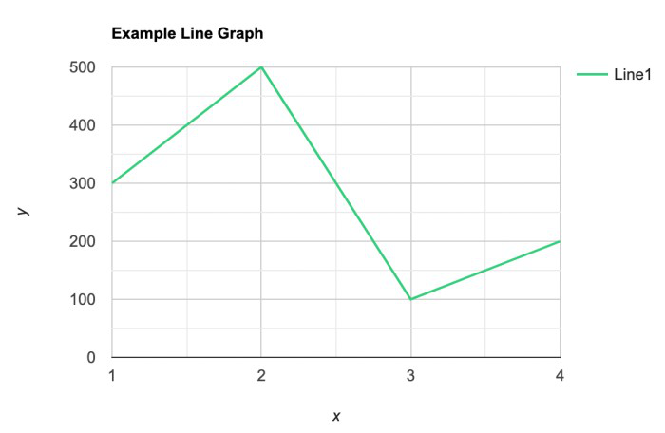
Types of Data: Numeric, Categorical, Graphical, High Dimensional
Types of Graphical Representations:
Line Graphs:
A line graph is used to show how the value of a particular variable changes with time. We plot this graph by connecting the points at different values of the variable. It can be useful for analyzing the trends in the data and predicting further trends.

Slide 47
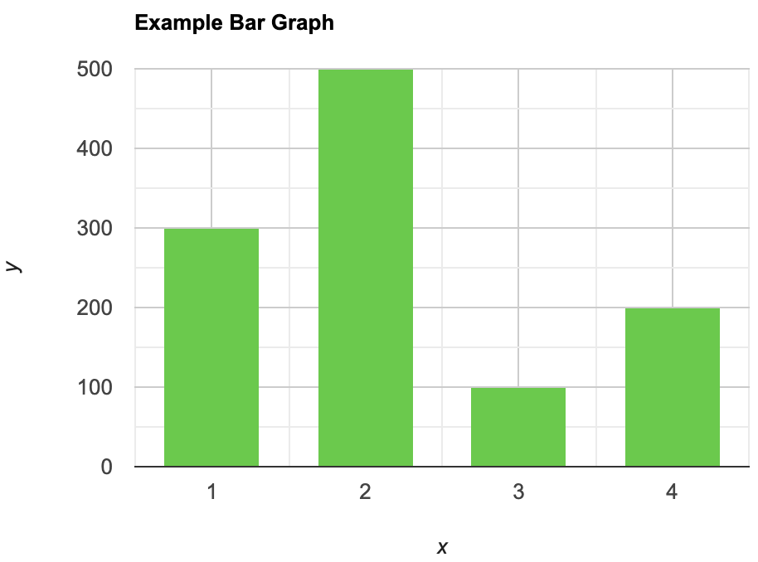
Types of Data: Numeric, Categorical, Graphical, High Dimensional
Types of Graphical Representations:
Bar Graphs:
A bar graph is a type of graphical representation of the data in which bars of uniform width are drawn with equal spacing between them on one axis (x-axis usually), depicting the variable. The values of the variables are represented by the height of the bars.

Slide 48
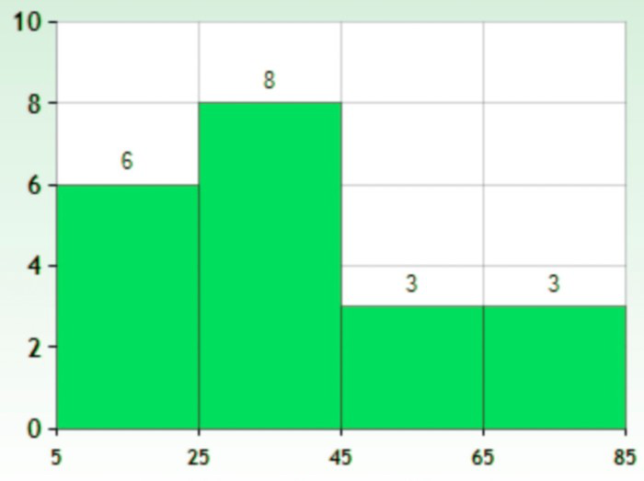
Types of Data: Numeric, Categorical, Graphical, High Dimensional
Types of Graphical Representations:
Histograms:
This is like bar graphs, but it is based frequency of numerical values rather than their actual values. The data is organized into intervals and the bars represent the frequency of the values in that range. That is, it counts how many values of the data lie in a particular range.

Slide 49
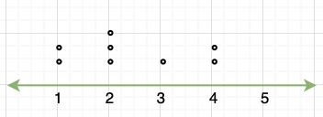
Types of Data: Numeric, Categorical, Graphical, High Dimensional
Types of Graphical Representations:
Line Plot:
It is a plot that displays data as points and checkmarks above a number line, showing the frequency of the point.
It is a plot that displays data as points and checkmarks above a number line, showing the frequency of the point.

Slide 50
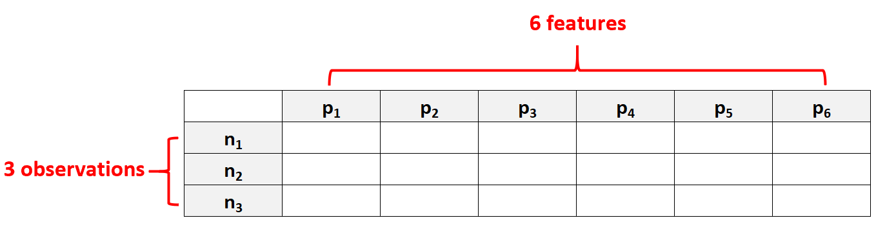
Types of Data: Numeric, Categorical, Graphical, High Dimensional
High Dimensional Data:
High dimensional data refers to a dataset in which the number of features p is larger than the number of observations N, often written as p >> N.
For example, a dataset that has p = 6 features and only N = 3 observations would be considered high dimensional data because the number of features is larger than the number of observations.
It is a plot that displays data as points and checkmarks above a number line, showing the frequency of the point.

Slide 51
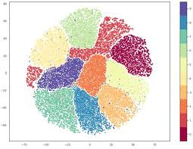
Types of Data: Numeric, Categorical, Graphical, High Dimensional
Why is High Dimensional Data a Problem?
When the number of features in a dataset exceeds the number of observations, we will never have a deterministic answer.
In other words, it becomes impossible to find a model that can describe the relationship between the predictor variables and the response variable, because we don’t have enough observations to train the model on.
It is a plot that displays data as points and checkmarks above a number line, showing the frequency of the point.

Slide 52
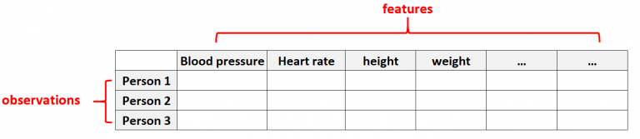
Types of Data: Numeric, Categorical, Graphical, High Dimensional
Examples of High Dimensional Data:
Healthcare Data
High dimensional data is common in healthcare datasets where the number of features for a given individual can be massive (i.e., blood pressure, resting heart rate, immune system status, surgery history, height, weight, existing conditions, etc.).
In these datasets, it’s common for the number of features to be larger than the number of observations.
It is a plot that displays data as points and checkmarks above a number line, showing the frequency of the point.

Slide 53
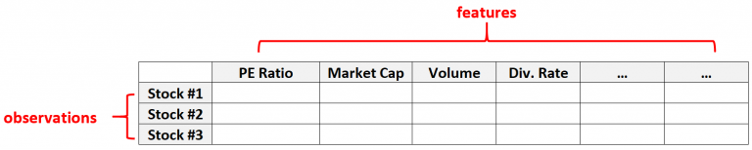
Types of Data: Numeric, Categorical, Graphical, High Dimensional
Examples of High Dimensional Data:
2. Financial Data:
High dimensional data is also common in financial datasets where the number of features for a given stock can be quite large (i.e. PE Ratio, Market Cap, Trading Volume, Dividend Rate, etc.)
In these types of dataset, it’s common for the number of features to be much greater than the number of individual stocks.
It is a plot that displays data as points and checkmarks above a number line, showing the frequency of the point.

Slide 54
Transactional, Spatial and Social Network Data
Transactional Data:
Transactional data is information that is captured from transactions.
It records the time of the transaction, the place where it occurred, the price points of the items bought, the payment method employed, discounts if any, and other quantities and qualities associated with the transaction.
Transactional data is usually captured at the point of sale.
In other words, transactional data is data generated by various applications while running or supporting everyday business processes of buying and selling.
A large and intricate web of point-of-sale servers, security software, ATM, and payment gateway data exists, originating from every possible device used to complete a financial transaction.

Slide 55
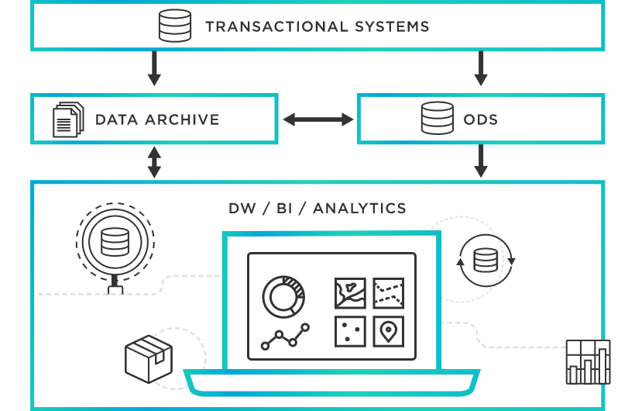
Transactional, Spatial and Social Network Data

Slide 56
Transactional, Spatial and Social Network Data
Examples of transactional data:
Transactional data typically falls under the category of structured data. Some examples include:
Financial transactional data: insurance costs and claims data, or a purchase or sale; Deposits or withdrawals in case of banks.
Logistical transactional data: shipping status, shipping partner data.
Work-related transactional data: employee hours tracking.

Slide 57
Transactional, Spatial and Social Network Data
Spatial data refers to information about the locations and shapes of objects or features on the Earth's surface. This type of data is crucial for various applications, including mapping, urban planning, environmental monitoring, and geographic information systems (GIS).
Here are some key concepts related to spatial data:
Coordinate Systems: Spatial data is often represented using coordinate systems, such as latitude and longitude for global locations or local grid systems for more specific areas.
Vector Data: This represents spatial data using geometric shapes like points, lines, and polygons. For example, a city might be represented as a point, a river as a line, and a forest as a polygon.
Raster Data: This type of data is represented in a grid format, where each cell (or pixel) has a value. Raster data is commonly used in remote sensing and imaging applications, such as satellite imagery.
Geocoding: This process involves converting addresses or other location-based information into geographic coordinates.
Spatial Analysis: This involves examining the spatial relationships and patterns within the data. Techniques might include overlay analysis, buffer analysis, and network analysis.

Slide 58
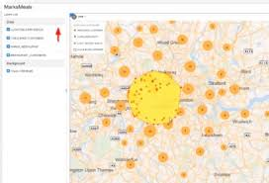
Transactional, Spatial and Social Network Data

Slide 59
Transactional, Spatial and Social Network Data
Social Network Data:
Social network data is commonly represented as a graph, where nodes correspond to individuals and edges symbolize the relationships between those individuals.
Social networks are the networks that depict the relations between people in the form of a graph for different kinds of analysis.
The graph to store the relationships of people is known as Sociogram. All the graph points and lines are stored in the matrix data structure called Sociomatrix. The relationships indicate of any kind like kinship, friendship, enemies, acquaintances, colleagues, neighbors, disease transmission, etc.

Slide 60
Standard datasets, Data Classification, Sources of Data
Each dataset is small enough to fit into memory and review in a spreadsheet. All datasets are comprised of tabular data and no (explicitly) missing values.
Swedish Auto Insurance Dataset.
Wine Quality Dataset.
Pima Indians Diabetes Dataset.
Sonar Dataset.
Banknote Dataset.
Iris Flowers Dataset.
Abalone Dataset.
Ionosphere Dataset.
Wheat Seeds Dataset.
Boston House Price Dataset.
It is a plot that displays data as points and checkmarks above a number line, showing the frequency of the point.

Slide 61
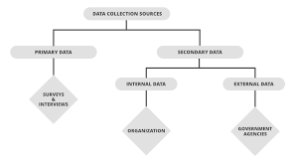
Standard datasets, Data Classification, Sources of Data​

Slide 62
Standard datasets, Data Classification, Sources of Data
1. Primary Source
It is a collection of data from the source of origin. It provides the researcher with first-hand quantitative and raw information related to the statistical study.
In short, the primary sources of data give the researcher direct access to the subject of research. For example, statistical data, works of art, and interview transcripts.
2. Secondary Source
It is a collection of data from some institutions or agencies that have already collected the data through primary sources.
It does not provide the researcher with first-hand quantitative and raw information related to the study.
Hence, the secondary source of data collection interprets, describes, or synthesizes the primary sources. For example, reviews, government websites containing surveys or data, academic books, published journals, articles, etc.
It is a plot that displays data as points and checkmarks above a number line, showing the frequency of the point.

Slide 63
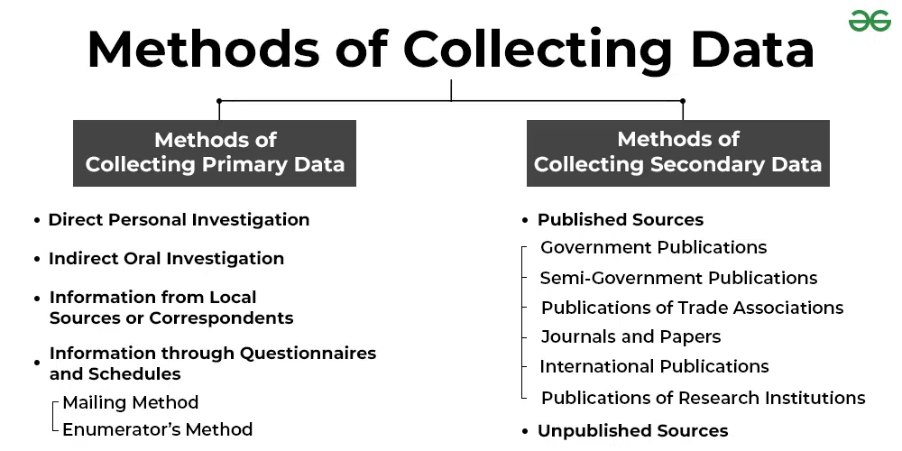
Standard datasets, Data Classification, Sources of Data
It is a plot that displays data as points and checkmarks above a number line, showing the frequency of the point.

Slide 64
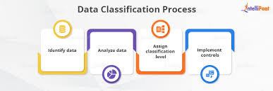
Standard datasets, Data Classification, Sources of Data
Data classification is broadly defined as the process of organizing data by relevant categories so that it may be used and protected more efficiently.
On a basic level, the classification process makes data easier to locate and retrieve.
Data classification is of particular importance when it comes to risk management, compliance, and data security.
Data classification involves tagging data to make it easily searchable and trackable. It also eliminates multiple duplications of data, which can reduce storage and backup costs while speeding up the search process.
It is a plot that displays data as points and checkmarks above a number line, showing the frequency of the point.

Slide 65
Standard datasets, Data Classification, Sources of Data
Types of Data Classification:
Data classification can be performed based on content, context, or user selections:
Content-based classification—
Content-based classification is a method used to categorize items (like text, images, or videos) based on their content.
This approach focuses on the actual features of the item, such as words in a document or colors in an image, instead of external factors (like metadata)..
For example, in text classification, algorithms analyze the words in a document to determine its topic. Similarly, in image classification, the algorithm looks at visual features like shapes or colors to classify the image.

Slide 66
Standard datasets, Data Classification, Sources of Data
Context-based classification—
Context-based classification is a method where the categorization of an item (like a text, image, or video) depends not just on the content but also on the context in which it appears.
This method considers surrounding information, relationships, and environmental factors that can provide deeper meaning to the content.
In text classification, a word like "bank" could have different meanings (financial institution vs. riverbank). Context-based classification looks at the surrounding words to figure out the right meaning.
User-based classification—
involves classifying files according to a manual judgement of a knowledgeable user.
Individuals who work with documents can specify how sensitive they are—they can do so when they create the document, after a significant edit or review, or before the document is released.

Slide 67
Data Manipulation in Various Formats
Data manipulation refers to the process of adjusting data to make it organized and easier to read.
Data manipulation and data modification are commonly used interchangeably.
With respect to data processing, the two are mutually exclusive.
Here’s why:
Data modification is when a computer’s saved value is changed to a different value. Thus, data is modified when it is stored in the same location.
Data manipulation is the process of pulling information from data by applying logic to generate a new set of data.
This example helps to clarify:
Data modification would be if you change the value in a spreadsheet’s cell from 100 to 150.
Data modification would be if you create a formula in Column B and apply it to the data in Column A to reap new data as a result in Column C.
It is a plot that displays data as points and checkmarks above a number line, showing the frequency of the point.

Slide 68
Data Manipulation in Various Formats
Purpose of Data Manipulation:
Data manipulation is a crucial function for business operations and optimization.
To properly use data and transform it into useful insights like analyzing financial data, customer behaviour and performing trend analysis, you must be able to work with the data in the way you need it.
As such, data manipulation provides many benefits to a business, including:
Consistent data: it usually means that the data is reliable, accurate, and follows the same format or structure throughout a dataset.
Having data in a consistent format allows it to be organized, read and better understood.
When you take data from different sources, you may not have a unified view, but with data manipulation and commands, you can make sure that your data is consistently organized and stored.
Project data: Being able to use historical data to project the future and provide more in-depth analysis is paramount for businesses, especially when it comes to finances.
Data manipulation makes this function possible.
It is a plot that displays data as points and checkmarks above a number line, showing the frequency of the point.

Slide 69
Data Manipulation in Various Formats
Create more value from the data:
Overall, being able to transform, edit, delete and insert data into a database means that you can do more with your data.
By having information that stays static, it becomes useless.
But, when you know how to use data to your benefit, you can have clear insights to make better business decisions.
‍Remove or ignore unneeded data:
Frequently, there is data that is unusable and can interfere with what matters.
Unnecessary or inaccurate data should be cleaned and deleted. With data manipulation, you can quickly cleanse your records so that you can work with the information that matters.
It is a plot that displays data as points and checkmarks above a number line, showing the frequency of the point.

Slide 70
Data Manipulation in Various Formats
Data Manipulation in CSV File:
A CSV file is a simple text that you can open in a wide variety of programs including programs for working with plain text such as Geany and Notepad [1]. It contains data which mostly separated by a comma. Other separators could be space, semicolons or other characters.
CSV stands for Comma-Separated Values, besides having a small size because contains plain text, it can be transformed into other forms such as SQL and Excel.
In Python, for manipulating some kinds of data including CSV files, there is Pandas (https://pandas.pydata.org), a Python Library which is a fast, powerful, flexible, easy and open-source tool for data analysis and manipulation [2].
We must have Python and Pandas installed on our computers for using Pandas.
If you don’t have Python yet in your computer, you can install a Python environment including Pandas and some Integrated Development Environment (IDE) by using anaconda (https://www.anaconda.com/products/distribution).
It is a plot that displays data as points and checkmarks above a number line, showing the frequency of the point.

Slide 71
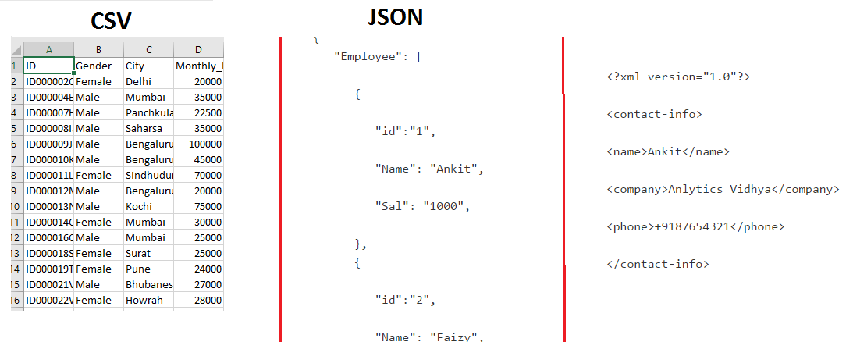
Data Manipulation in Various Formats

Slide 72
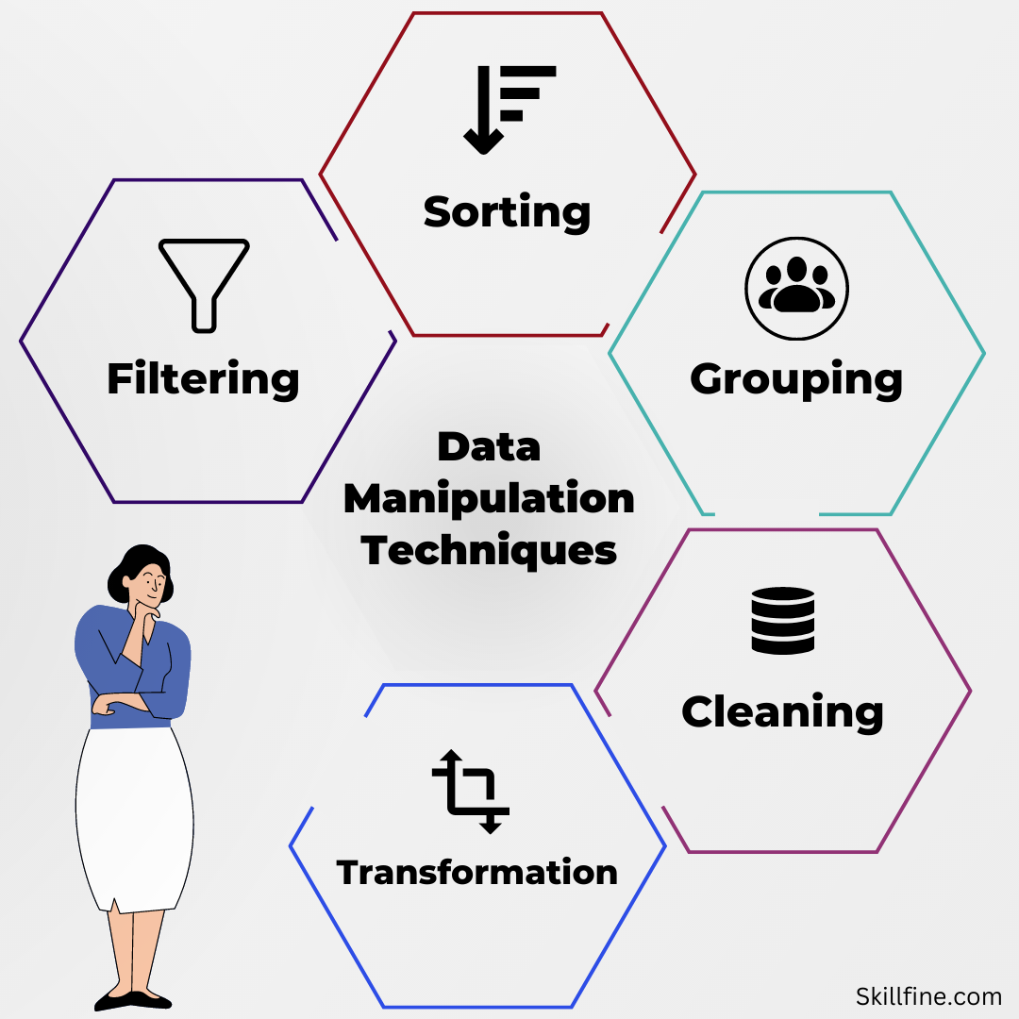
Data Manipulation in Various Formats
Data Manipulation in Excel:
It is a plot that displays data as points and checkmarks above a number line, showing the frequency of the point.

Slide 73
Data Manipulation in Various Formats
Data Manipulation in Excel:
Filtering
Filtering is a process of sorting data by a certain criteria. It’s an effective way to identify subsets of data from the larger dataset.
2. Sorting
Sorting is another technique of data analysis and is used to rearrange the order of your data. It’s an easy way of exploring and understanding your data.
3. Grouping
Grouping is an excellent way to analyze your data. Grouping is when you organize data into smaller sets. You can use this technique to make it easier to analyze the relationships in your data like quantifying average, total, and percentage.
4. Pivoting
Pivoting data involves taking a data table and turning it on its side to show an aggregate perspective.
Pivot Tables in Excel are a powerful tool for data manipulation. They allow you to quickly summarize, analyze, explore, and present large amounts of data.
It is a plot that displays data as points and checkmarks above a number line, showing the frequency of the point.

Slide 74
Data Manipulation in Various Formats
Data Manipulation in Excel:
5. Transposing
Data can be transposed by using the Excel Transpose function. It is a very efficient way to take any data.
6. Changing Data Types
One thing that might be useful to know is how changing data types can affect your data analysis. This can be done through excel text functions.
7. Adding Columns and Rows
Adding columns or rows to your data is a great way to make your work more efficient.
For instance, if you were working with a table of data on different subjects and wanted to look at their answers in relation to each other, it would be more convenient for you (and the people you’re sharing the data with) if you had both answers in one column.
It is a plot that displays data as points and checkmarks above a number line, showing the frequency of the point.

Slide 75
Data Manipulation in Various Formats
8. Naming Columns or Rows
Every column and row in a spreadsheet has a default name, but these names can be changed. This is helpful when you’re summarizing data and want to apply the same column or row title consistently.
9. Inserting Columns or Rows
One of the simplest data manipulation techniques in Excel is inserting columns or rows.
It is a plot that displays data as points and checkmarks above a number line, showing the frequency of the point.

Slide 76
Data Manipulation in Various Formats
XLSX files
XLSX is a Microsoft Excel Open XML file format. It also comes under the Spreadsheet file format. It is an XML-based file format created by Microsoft Excel. The XLSX format was introduced with Microsoft Office 2007.
In XLSX data is organized under the cells and columns in a sheet. Each XLSX file may contain one or more sheets. So a workbook can contain multiple sheets.

Slide 77
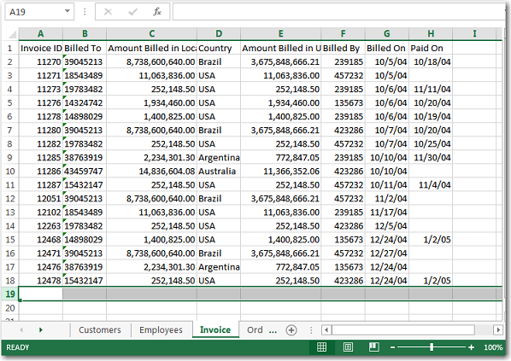
Data Manipulation in Various Formats
XLSX files
The below image shows a “xlsx” file which is opened in Microsoft Excel.

Slide 78
Data Manipulation in Various Formats
Plain Text (txt) file format
In Plain Text file format, everything is written in plain text. Usually, this text is in unstructured form and there is no meta-data associated with it. The txt file format can easily be read by any program. But interpreting this is very difficult by a computer program.

Slide 79
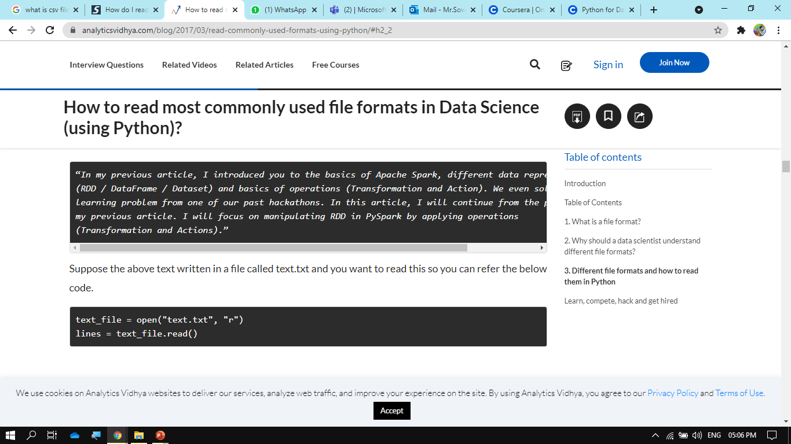
Data Manipulation in Various Formats
Plain Text (txt) file format
Let’s take a simple example of a text File.
The following example shows text file data that contain text:

Slide 80
Data Manipulation in Various Formats
JSON file format
JavaScript Object Notation(JSON) is a text-based open standard designed for exchanging the data over web. JSON format is used for transmitting structured data over the web. The JSON file format can be easily read in any programming language because it is language-independent data format.

Slide 81
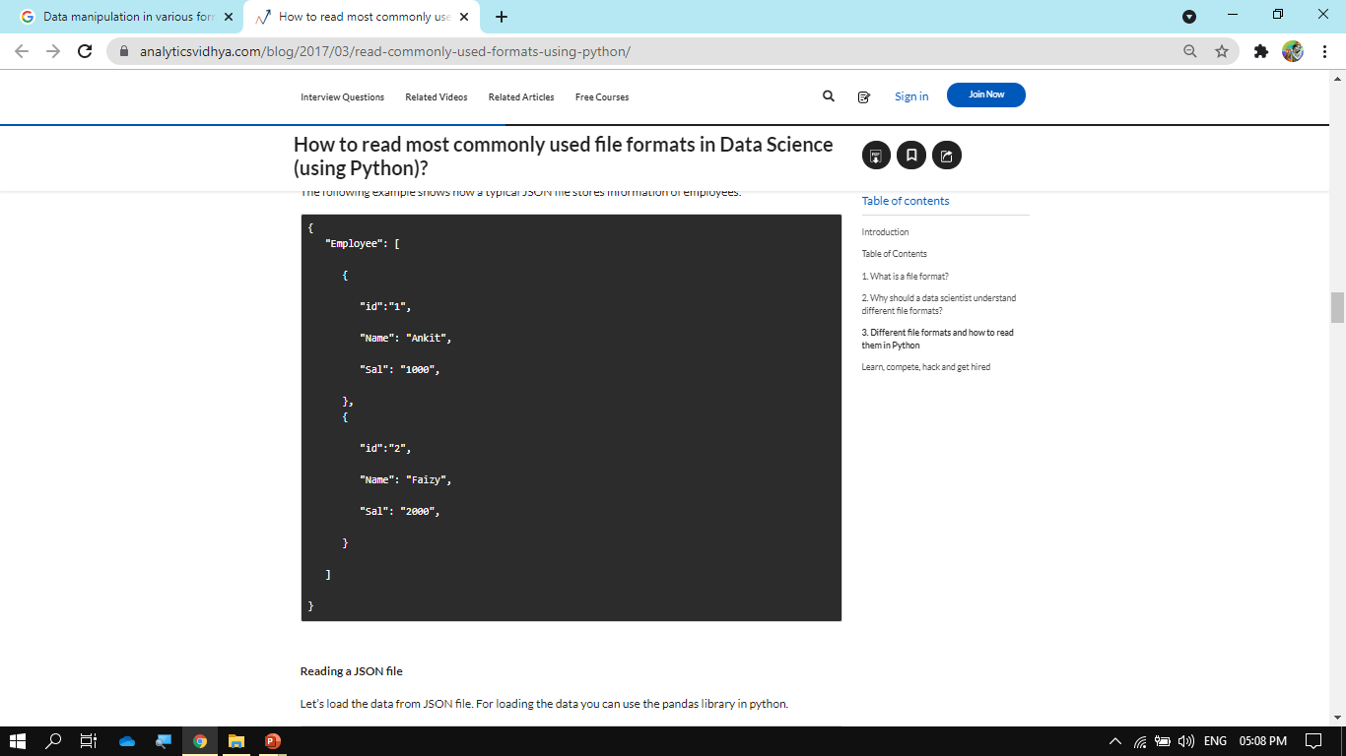
Data Manipulation in Various Formats
JSON file format:

Slide 82
Data Manipulation in Various Formats
HTML files
HTML stands for Hyper Text Markup Language. It is the standard markup language which is used for creating Web pages. HTML is used to describe structure of web pages using markup. HTML tags are same as XML but these are predefined. You can easily identify HTML document subsection on basis of tags such as <head> represent the heading of HTML document. <p> “paragraph” paragraph in HTML. HTML is not case sensitive.

Slide 83
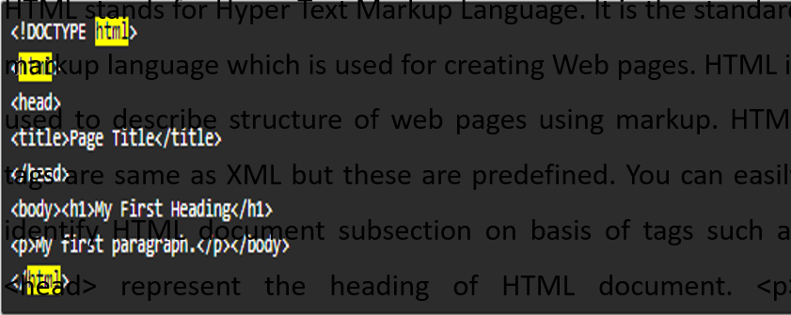
Data Manipulation in Various Formats

Slide 84
Data Manipulation in Various Formats
Image files
Image files are probably the most fascinating file format used in data science. Any computer vision application is based on image processing.
an Image consisting of pixels and meta-data associated with it. Each image consists one or more frames of pixels. And each frame is made up of two-dimensional array of pixel values. Pixel values can be of any intensity. Meta-data associated with an image, can be an image type (.png) or pixel dimensions.

Slide 85
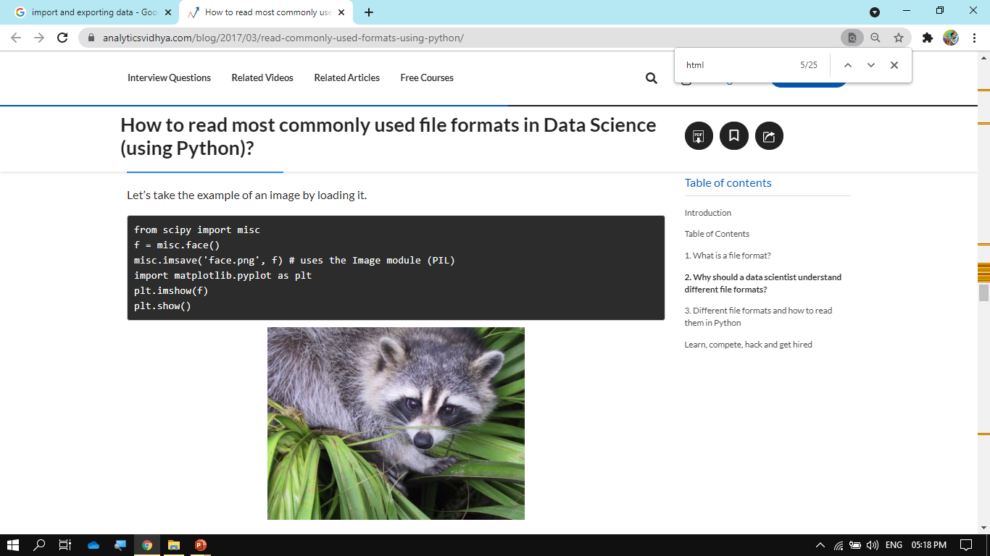
Data Manipulation in Various Formats
Image files

Slide 86
Data Manipulation in Various Formats
You Tube video
https://www.youtube.com/watch?v=uufDGjTuq34
https://www.youtube.com/watch?v=XVv6mJpFOb0
https://www.youtube.com/watch?v=guPOL9UplNs
https://www.youtube.com/watch?v=ve_0h4Y8nuI&list=PLhTjy8cBISEqkN-5Ku_kXG4QW33sxQo0t
https://www.youtube.com/watch?v=pLoRrHEsHb0&list=PLmcBskOCOOFUmbUv0CIMuATDVKVrOhBMV

Slide 87
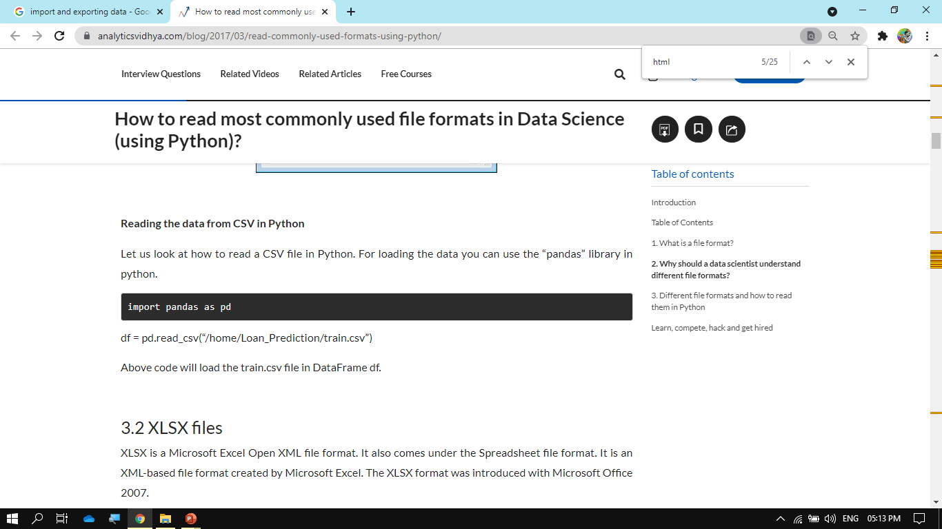
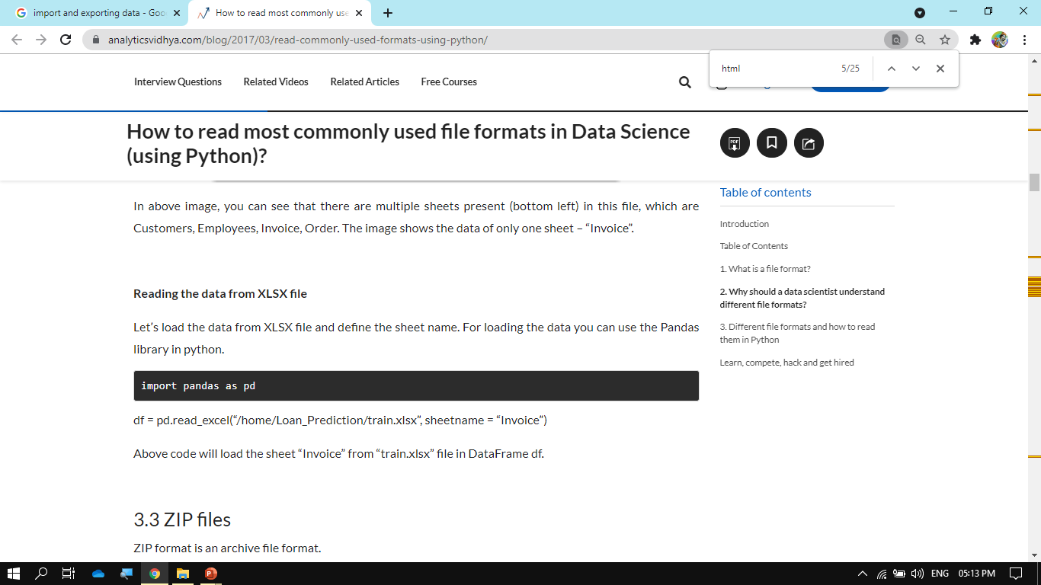
Import and export data

Slide 88
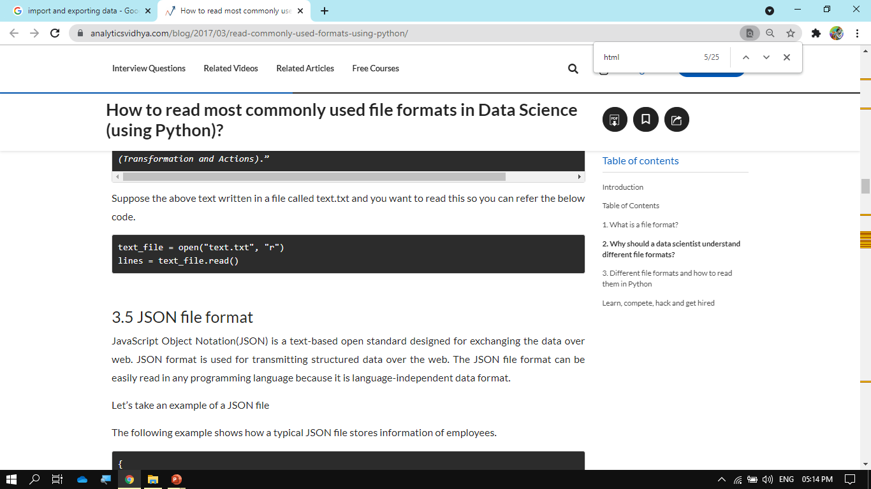
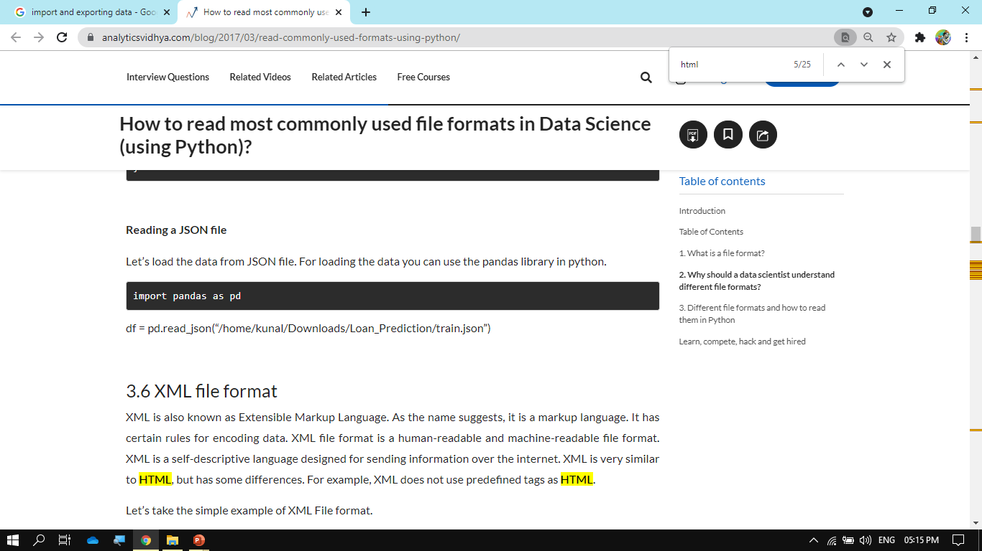
Import and export data

Slide 89
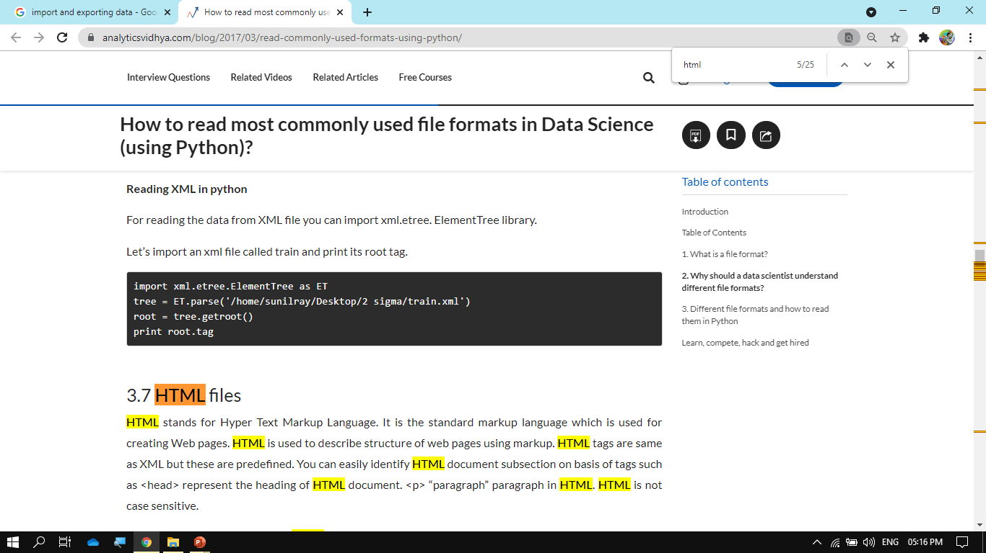
Import and export data
Reading the HTML file
For reading the HTML file, you can use BeautifulSoup library. Please refer to this tutorial, which will guide you how to parse HTML documents. Beginner’s guide to Web Scraping in Python (using BeautifulSoup)

Slide 90
Import and export data
PDF file format
PDF (Portable Document Format) is an incredibly useful format used for interpretation and display of text documents along with incorporated graphics. A special feature of a PDF file is that it can be secured by a password.
Reading a PDF file
On the other hand, reading a PDF format through a program is a complex task. Although there exists a library which do a good job in parsing PDF file, one of them is PDFMiner. To read a PDF file through PDFMiner, you have to:
Download PDFMiner and install it through the website
https://euske.github.io/pdfminer/
Extract PDF file by the following code
pdf2txt.py <pdf_file>.pdf

Slide 91
Weekly/Monthly Assignment
How do you identify data sources?
What is primary source of data?
What is meant by data manipulation?
Give two examples of numerical data.
Why do we represent data graphically.
What is a dataset?
What is high and low dimension data?
What is transactional data?
What is the difference between data manipulation and data modification?
List various methods to collect primary data.

Slide 92
Weekly/Monthly Assignment
What is Data Manipulation?
Define Outliers. How are they identified?
Name some methods to deal with missing value imputation?
Explain the standardization scaling method to normalize data.
Name top 2 techniques to handle missing data.
Define standardization.
What precautions shall we take while using secondary data?
What are the methods of primary data collection?
What is Categorical Data?

Slide 93
Glossary Questions
Type of numeric data includes …...............
XML is an example of …................
Primary data is original data?
Numeric data is also known as...............
Sharing of user's location comes under..............

Slide 94
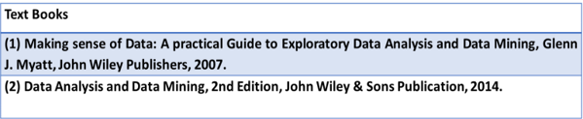
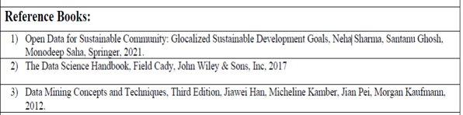
References

Slide 95
1. How do you deal with high dimensional data?
2. List some additional sources of data. 3. Differentiate between categorical and numerical data. 4. Explain the steps involved in data manipulation. 5. List various methods of collecting secondary data.
Expected Questions for End Semester Exam

